Slide 1
Kyiv’s neighborhood
Capstone project, Andrii Yevtukh

Slide 2
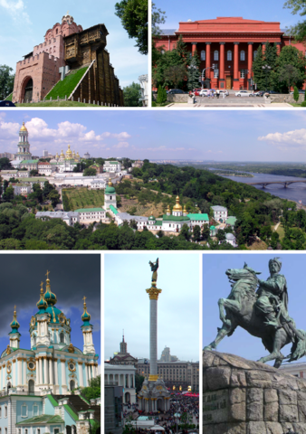
Introduction
Kyiv is a biggest Ukrainian city with relatively high population(3 million), square (84 square kilometers)and long history(its age is approximately 1500+ years).
The city lies on a so-called crossroad between East and West and experienced a lot of adventures during its history. Many of them influenced on architectural view and venues density.
In the end, the city consists of 10 boroughs and conditions in them again, are pretty different- from almost river side height to hills, from concrete jungle to lakes and forests nearby.
So, as you can see finding a flat in such city could be a tricky
question

Slide 3
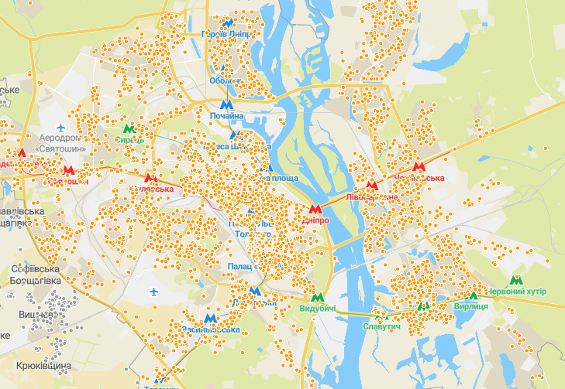
Problem and goals
I’m a resident of Kyiv and at certain point of time my family decided to change a flat. At the start point, the main condition was a price, but after viewing few variant some extra more issues has appeared.
In addition, amount of possible variants didn’t make our lives easier..
I decided to create a project which will allows
me and my family member’s to spare
some time, nerves and get the prefect flat in
perfect surrounding as result

Slide 4
Data description
Real-estate site data taken from https://flatfy.lun.ua/
Google map geo location
Forsquare API
Total crime amount divided by boroughs - https://mvs.gov.ua/
Density of population- https://kyivcity.gov.ua/

Slide 5
Methodology
Request data from Foursquare about nearby venues and gather it on city map together with our initial data set

Slide 6
Methodology
Still a lot of options, so I requested data form Foursquare based on geo data for all apartments and set limitation for venues within 500 meters from which of apartment.
And after brainstorming, we came up with certain amount of categories which seems to be relevant for all of us. And I added weights to all of categories.

Slide 7
Methodology
Now our data set is cleaned and sorted, so I started final preparation of data set for clusterization:
- Using one hot encoding, transform venue.
- Group rows by apartment and by taking the max of occurrence of each category.
- Set weight for each venue.
- Normalize data by rows, (using sklearn.pre-processing.normalize

Slide 8
Methodology
Then I found the number of clusters using ‘elbow method’.
And create a clusters themselves using k-means clustering

Slide 9
Methodology
And here is a clustered representation of clustered data

Slide 10
Methodology
The choice isn’t optimal yet, so I decided to add one more parameter, very important one – safety.
The estimation of safety could become another problem, but I decided to use quite common method- namely, take the total rate of crimes per boroughs and divide it on density of population per borough.
This action gave me an approximate average crime rate per borough which I applied to my table

Slide 11
Results
After applying all these filters, I got following overview with relatively obvious options:

Slide 12
Discussion
First of all, based on the results of this project I was able to find the most suitable results from huge variety of options. And even though there are still plenty of data which I’ll have to check and analyze, the variety of choices were decreased dramatically.
Secondly, this project gave me unique possibility to take a part in overall process- from defining business problem to the very end of analyzing it. This is not something what you could easily do on daily basis.
And last, but not least, I would say that project described in this report has a huge potential to grow into something much more useful and powerful.
Just imaging that you could not only find a general info about a flat on the real-estate site, but also :
- check what’s nearby this flat – and not only in general but also select something specifically relevant for you (dance school? Yoga? Anything else?)
- compare air clearance and crime rate, check if the territory where the building placed isn’t overheating/under heating, and so on.
- Furthermore, I’d be happy to see a recommendation and likes system applied to everything- starting from house keeper quality of service and ending with water supply/electricity isuses if there are any.

Slide 13
Conclusion
- There are plenty of variants which suits our initial requirements, so the choice was not so obvious
- Adding extra criteria helps me to reduce the amount of options from 182 to 39 which is quite good results
- The best option within criteria we defined are parts of clusters 0,1,3 and 5
- However, we still need to visit these places to make sure that they will meet our needs
- At the end, this project was sometimes demanding and challenging, but very interesting experience. I hope I’d be able to make a good use of knowledge I got during the course

Slide 14
Thank you for your attention!

